Slide 1
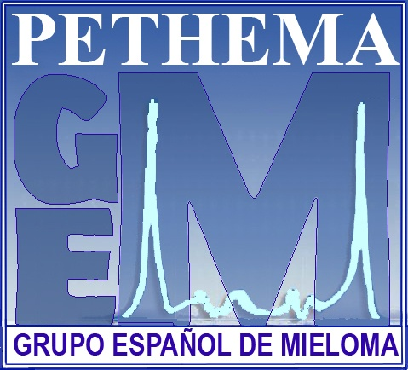
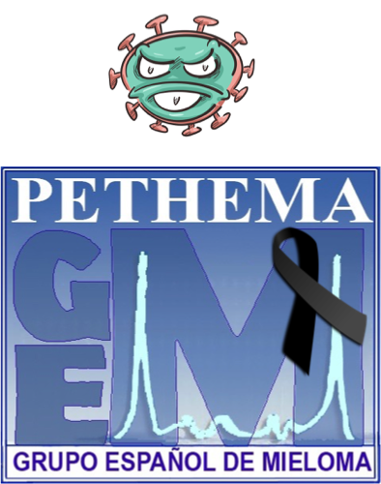


Severity of Covid-19 Clinical Outcomes and
Mortality in Multiple Myeloma Patients over Year
1 of the Pandemic
Joaquin Martinez-Lopez
Hospital 12 de Octubre. CNIO. Complutense University. Madrid. Spain
On behalf of Spanish Myeloma Group (GEM)
Notes:
Aprendidas: aún mucha incertidumbre

Slide 2
Disclosers
No disclosers for this presentation
Notes:
Aprendidas: aún mucha incertidumbre

Slide 3
First wave
Mortality MM 34% vs 23% non Cancer
Risk factor:
Age
Active disease
Male
Renal Impairment
Martinez-Lopez J et al; Blood Cancer J. 2020

Slide 4
HEMATO-MADRID COVID19, first year of pandemic Mar 20-Feb 21 Questions?
Did Severity and mortality change over the first year of pandemic?
Is post-Acute COVID-19 relevant in HM?
Have we improved?

Slide 5
Flow Chart and cases, First year of Pandemic

Slide 6
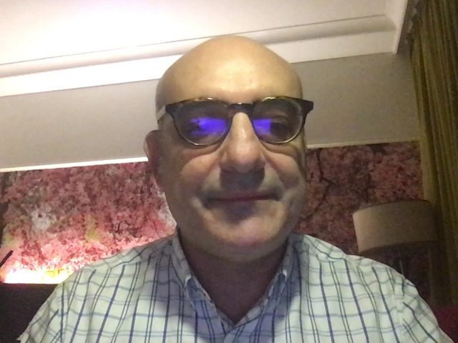
COVID-19 in Multiple Myeloma by Periods
MM patients with active or progressive disease at time of Covid-19 diagnosis were 24% in P1 and 34% in P2, p=0.05;
Active treatment were more frequent in P1, 89%, than in P2, 79%, p=0.01. MM treatment was withheld in 78% and 82% of patients, p=0.4.
Covid-19 treatment changed over time:
MM patients received more remdesivir and corticoids in the second period
(3% vs 31% p<0.001, and 49% vs 73%, p<0.001, respectively).
Independently of the study period, an increased mortality was observed in men (OR 1.81, 1.08-3.05), patients over 65 (OR 2.40, 1.33-4.36), and patients with active or progressive disease (OR 2.12, 1.24-3.62).

Slide 7

Mortality and Severity overtime by COVID-19 in HM
Mortality Early vs Late
P= 0.5
However, mortality in all reported patients was 30.7% in P1 vs 26.1% in P2, p=0.3; and no differences in mortality were observed in hospitalized patients, 32.2% in P1 and 35.3% in P2, p=0.6

Slide 8


COVID-19 in MM: Conclusions
Although the severity has decreased (for obvious reasons), mortality remains very high in MM with SARS-CoV-2 infection
Prognostic Factors are:
Age >65
Sex: Men
Active disease
The improvement in the clinical management of patients with COVID-19 without cancer has not been transferred to patients with COVID-19 and MM
Notes:
our findings suggest that withholding (cancelar/retirar) specific effective treatments from patients with haematological malignancies during the COVID-19 pandemic is not justified (quizá anti Cd20 en LF mantenimiento…)
Prolonged detection of viral RNA, for up to 2 months in a subset of patients, has not been reported in the immunocompromised setting (Zheng, Fan et al. 2020). Prolonged persistence in haematooncology
patients has significant implications for scheduling subsequent chemotherapies, shielding and self-isolation

